Slide 1

Mobile Sales Analysis
EDA and answers to Section 2 (Q1-Q10) · 17 brands · 3,006 listings
Suman Bajani
BWU/MCA/25/039
Sec: A
Notes:
1

Slide 2
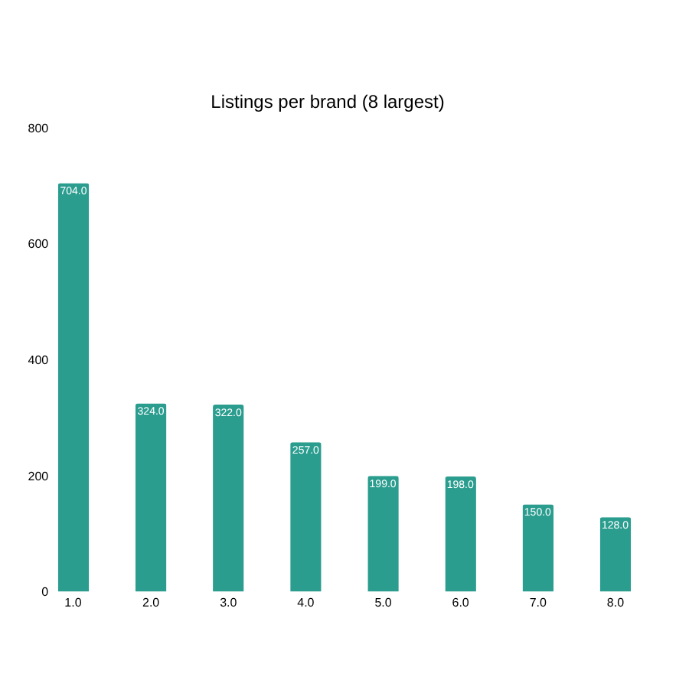
EDA
Dataset overview and cleaning
3,006
17 / 922
listings after removing 108 duplicate rows (3,114 raw)
brands / unique mobile names; Samsung alone has 704 rows
₹14,999
4.23
median selling price vs ₹25,842 mean: strongly right-skewed
average rating (range 2.3-5.0); ratings are tightly clustered
Notes:
2

Slide 3
EDA
Distributions and data-quality issues
Variable | Mean | Median | Max
Selling price (₹) | 25,842 | 14,999 | 179,900
Original price (₹) | 27,723 | 15,999 | 189,999
Discount (₹) | 1,880 | 0 | 75,000
Discount (%) | 6.1 | 0 | 70.6
Rating | 4.23 | 4.30 | 5.0
ANSWER
Messy memory and storage
377 price outliers (premium iPhones and foldables) were kept as genuine. Over half of listings have no discount.
66 rows have odd storage (89, 129, 153 GB). RAM reaches 768 GB, so some values are in MB or swapped. Storage "1" means 1 TB. This affects Q8-Q10.
Notes:
3

Slide 4
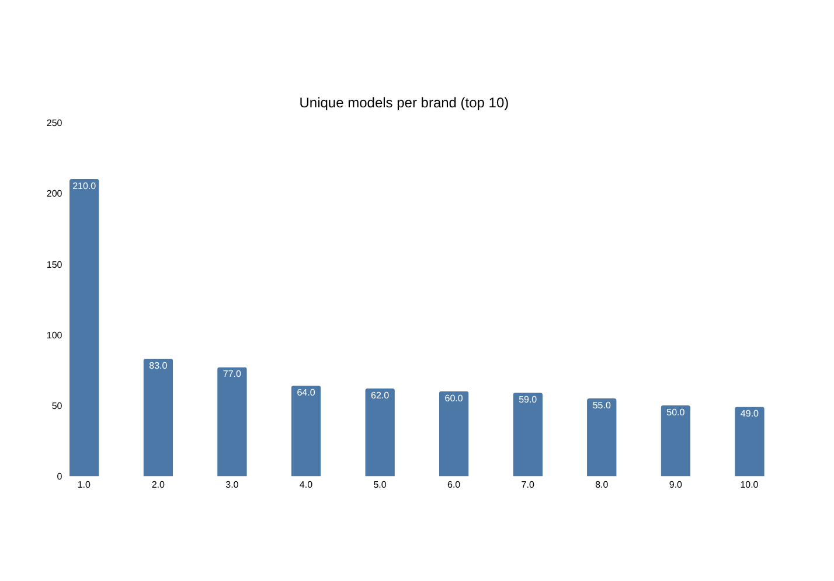
Q1
Which brand has the most mobile models?
ANSWER
Samsung: 210
Samsung has 210 unique models, 2.5x the next brand, Nokia (83), then Oppo (77). Apple has only 25 models but 324 listings (many storage and colour variants).
Notes:
4

Slide 5
Q2
Top 10 models by selling price
# | Model | RAM/Storage | Price ₹ | Rating
1 | Apple iPhone 13 Pro Max | 4/1 TB | 179,900 | 4.7
2 | Apple iPhone 13 Pro Max | 6/1 TB | 179,900 | 4.2
3 | Apple iPhone 13 Pro Max | 6/89* | 179,900 | 4.2
4 | Samsung Fold 2 5G | 12/256 | 169,999 | 4.2
5 | Apple iPhone 13 Pro | 6/1 TB | 169,900 | 4.2
6 | Apple iPhone 13 Pro Max | 6/512 | 159,900 | 4.2
7 | Apple iPhone 13 Pro Max | 4/512 | 159,900 | 4.7
8 | Samsung Galaxy Z Fold3 5G | 12/512 | 157,999 | 4.4
9 | Apple iPhone 11 Pro Max | 4/512 | 150,800 | 4.7
10 | Samsung Galaxy Z Fold3 5G | 12/256 | 149,999 | 4.4
ANSWER
₹179,900
Apple iPhone 13 Pro Max (1 TB) is the most expensive. Only Apple and Samsung (foldables) appear in the top 10.
*89 is a data-entry error. Each row is one model variant.
Notes:
5

Slide 6
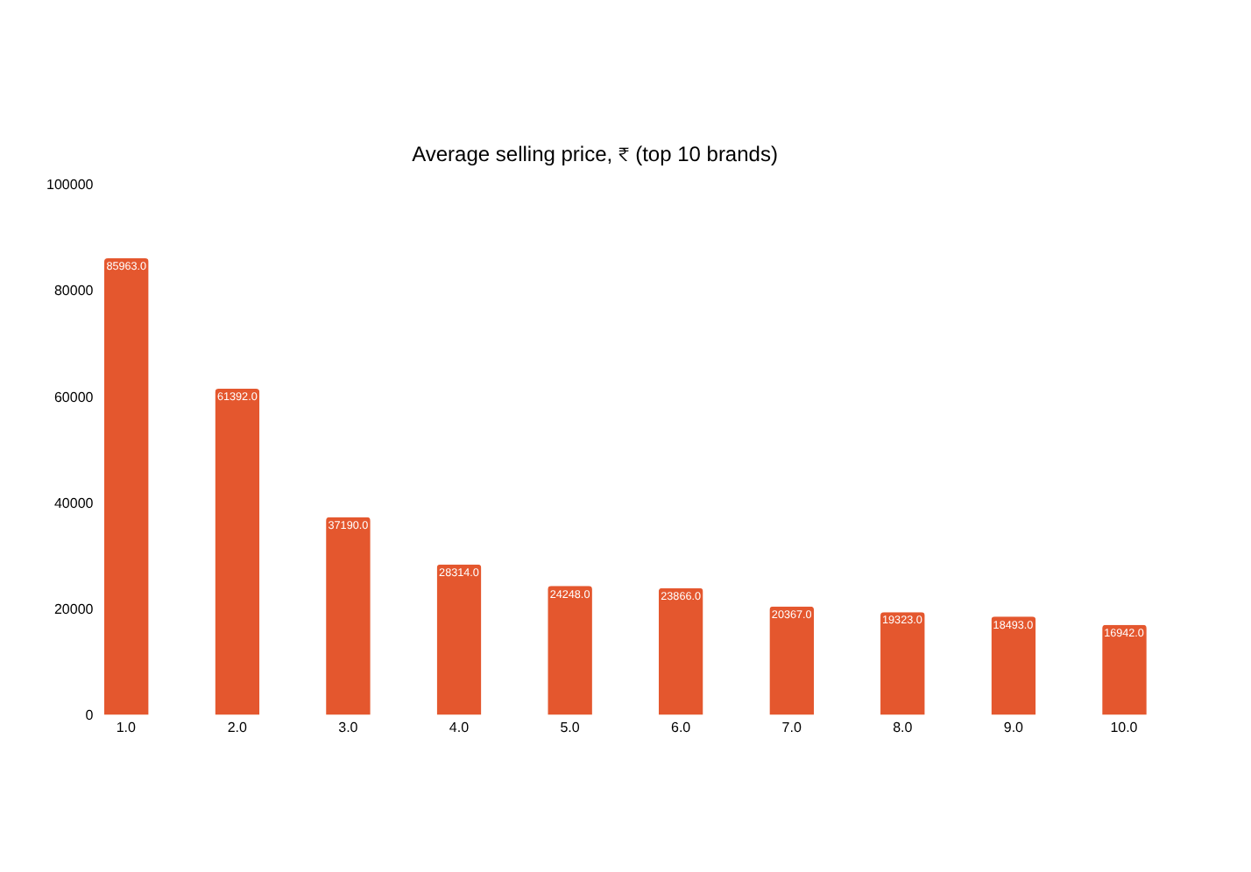
Q3
Average selling price per brand
ANSWER
Apple: ₹85,963
Apple is highest, followed by Google Pixel (₹61,392). Gionee is the lowest at ₹7,174. The market average is ₹25,842, so only Apple and Google Pixel sit far above it.
Notes:
6

Slide 7
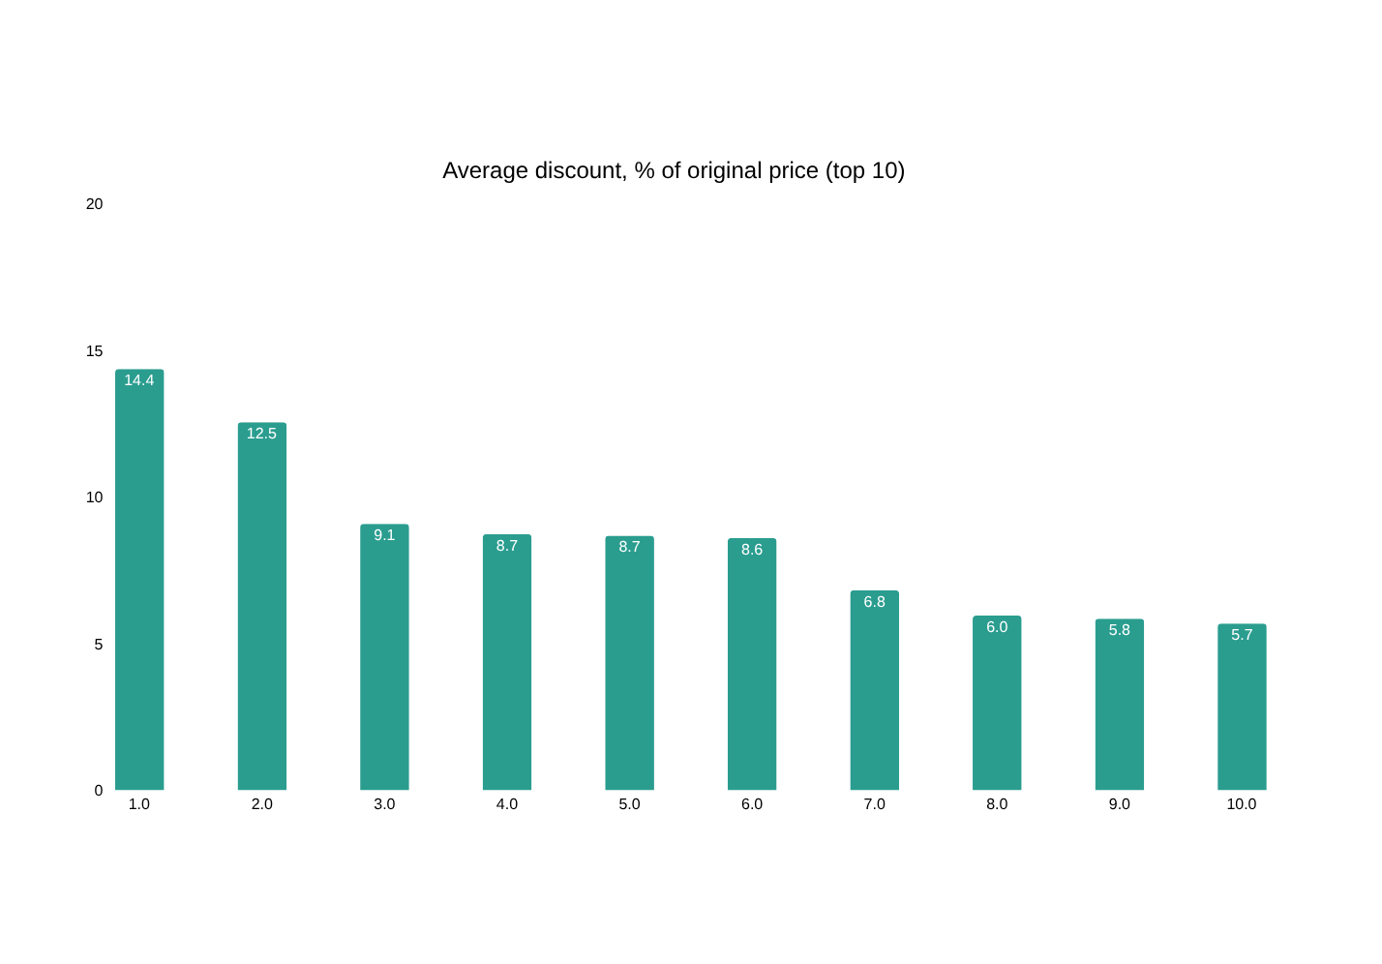
Q4
Which brand offers the highest average discount?
ANSWER
Motorola by amount
Poco by %
Motorola gives the largest average discount in rupees (₹4,289); Poco gives the largest share, 14.3% off the original price (₹2,615 on average).
Notes:
7

Slide 8
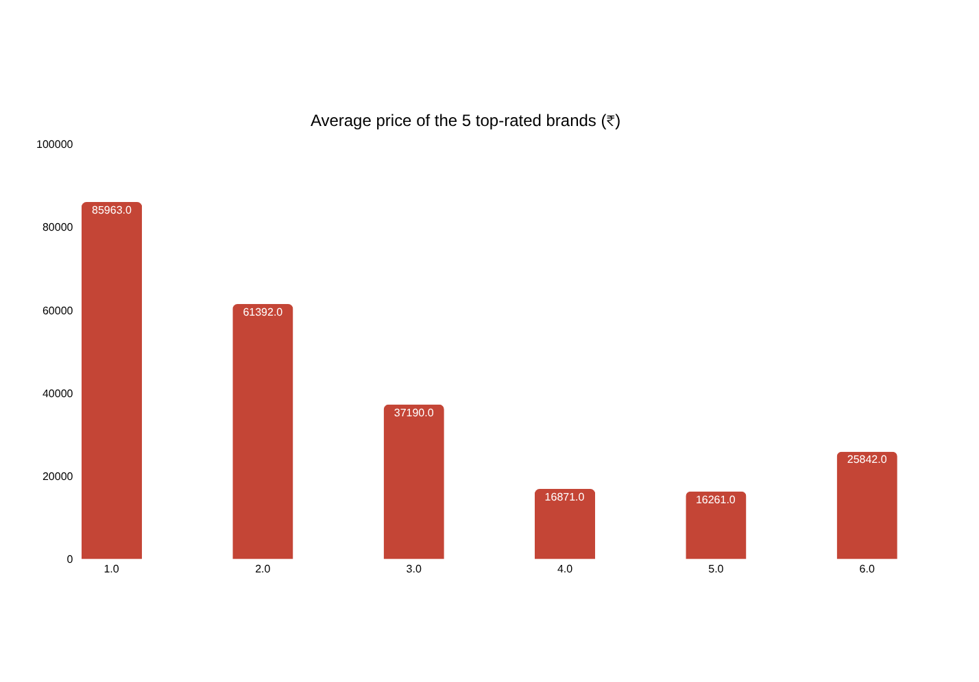
Q5
Highest-rated brands and their prices
ANSWER
Apple and Google Pixel (4.51)
Next: Iqoo 4.40, Poco 4.39, Realme 4.38 (5+ rows). Apple is 233% above the market average price, Pixel 138% above; Poco and Realme are about 35% below yet rate almost as high. Price and rating correlate across brands (rho = 0.52).
Notes:
8

Slide 9
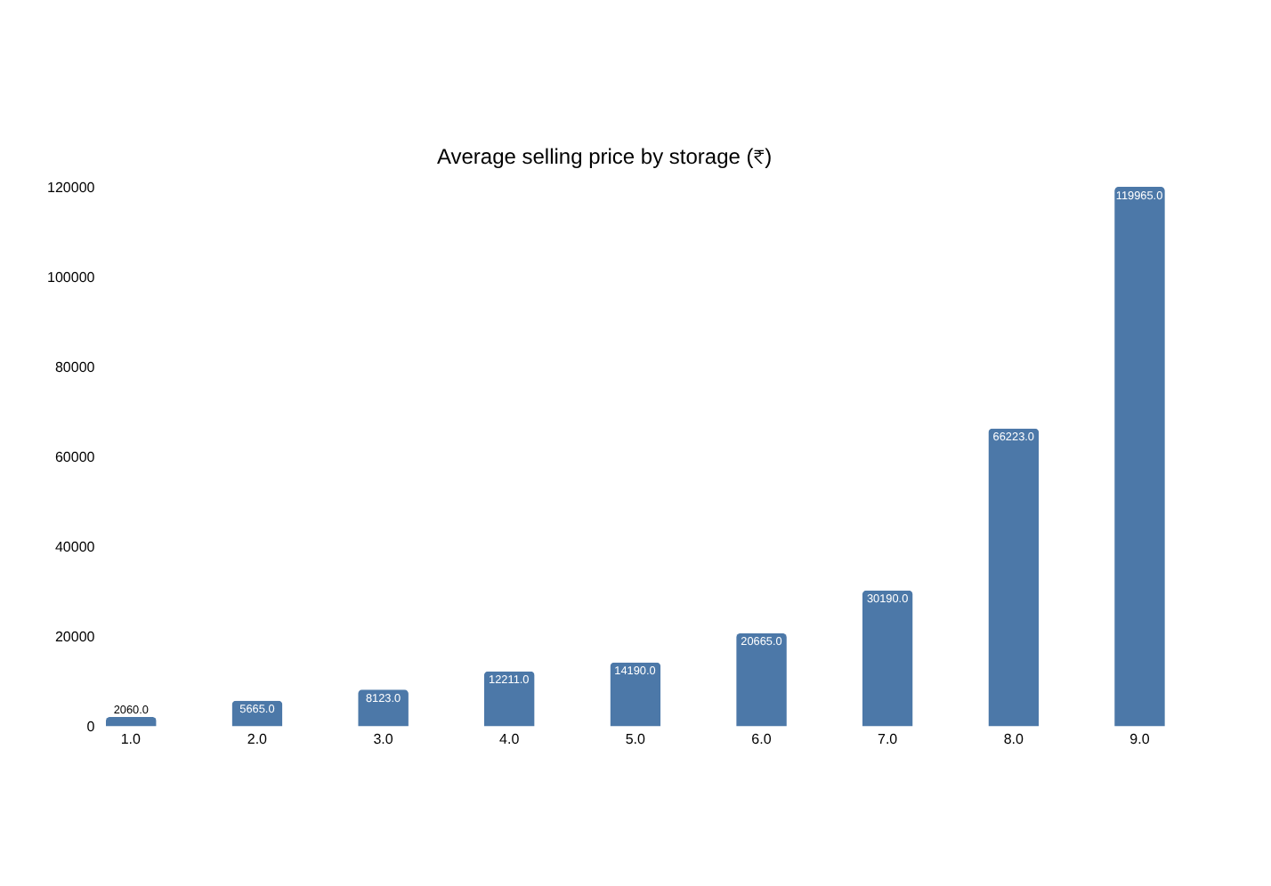
Q6
How storage affects selling price
ANSWER
Price climbs with storage
Spearman rho = 0.71. Average price grows from ₹2,060 (2 GB) to ₹119,965 (512 GB). The biggest jumps are 256 GB (2.2x the 128 GB price) and 512 GB (1.8x). Average rating also rises, from 4.05 at 16 GB to 4.46 at 512 GB.
Notes:
9

Slide 10
Q7
Biggest discounts and % of original price
# | Model | Original | Discount ₹ | % off
1 | Motorola Razr | 149,999 | 75,000 | 50.0
2 | Motorola Razr 5G | 149,999 | 60,000 | 40.0
3 | ASUS ROG | 83,999 | 57,500 | 68.5
4 | LG Wing | 80,000 | 50,001 | 62.5
5 | Apple iPhone XS Max (256) | 124,900 | 45,901 | 36.8
6 | LG G8X | 70,000 | 42,010 | 60.0
7 | Samsung Galaxy Fold 2 | 189,999 | 40,000 | 21.1
8 | Samsung Galaxy Note 8 | 74,000 | 39,101 | 52.8
9 | Apple iPhone XS Max (64) | 109,900 | 35,901 | 32.7
10 | Samsung Galaxy S6 Edge+ | 61,988 | 33,988 | 54.8
ANSWER
Motorola Razr: ₹75,000 off
That is 50.0% of its original price. Across the top 10 the discount ranges from 21% to 68.5% of the original price; ASUS ROG (68.5%) and LG Wing (62.5%) are the deepest cuts.
Notes:
10

Slide 11
Q8
Best balance of price and rating (memory + storage)
Storage | Avg price ₹ | Avg rating | Listings
16 GB | 12,211 | 4.05 | 334
32 GB | 14,190 | 4.17 | 550
64 GB | 20,665 | 4.29 | 754
128 GB | 30,190 | 4.33 | 752
256 GB | 66,223 | 4.43 | 222
512 GB | 119,965 | 4.46 | 63
ANSWER
64-128 GB tier
Rating goes 4.29 (64 GB), 4.33 (128 GB), 4.43 (256 GB), but price doubles from ₹30,190 to ₹66,223 at 256 GB. So 64-128 GB gives the best rating for the money.
RAM + storage combos could not be ranked reliably: the first run picked '14 GB RAM / 2 GB', an artefact of mixed MB/GB values. This table uses storage tiers, which are clean.
Notes:
11

Slide 12
Q9
Top 10 value for money (value score)
# | Model | RAM/Stor. | Price ₹ | Disc % | Rating | Score
1 | SAMSUNG Guru Plus B110 | 512/512 | 1,700 | 0 | 4.2 | 68
2 | SAMSUNG SM-B310EZDDINS | 100/100 | 1,949 | 0 | 5.0 | 65
3 | GIONEE Pioneer P3 | 512/4 | 2,350 | 71 | 3.6 | 63
4 | Nokia 8110 | 512/4 | 3,000 | 64 | 3.7 | 62
5 | Nokia Asha 311 | 512/140 | 5,999 | 13 | 4.0 | 59
6 | SAMSUNG Guru GT | 153/153 | 1,549 | 0 | 4.1 | 58
7 | ASUS ROG | 8/128 | 26,499 | 68 | 4.3 | 57
8 | Lenovo A269i | 512/512 | 5,499 | 0 | 3.7 | 57
9 | SAMSUNG GURU FM PLUS | 4/256 | 1,662 | 0 | 4.2 | 57
10 | LG G8X | 6/128 | 27,990 | 60 | 4.4 | 57
ANSWER
Only 2 rows hold up
Score = rating 30%, price 25% (lower is better), discount % 15%, RAM 15%, storage 15%, each scaled 0-1. Fake RAM values let feature phones win. Valid: ASUS ROG (68% off, 4.3) and LG G8X (60% off, 4.4).
Grey italic rows have impossible specs (RAM listed as 512, 153...).
Notes:
12

Slide 13
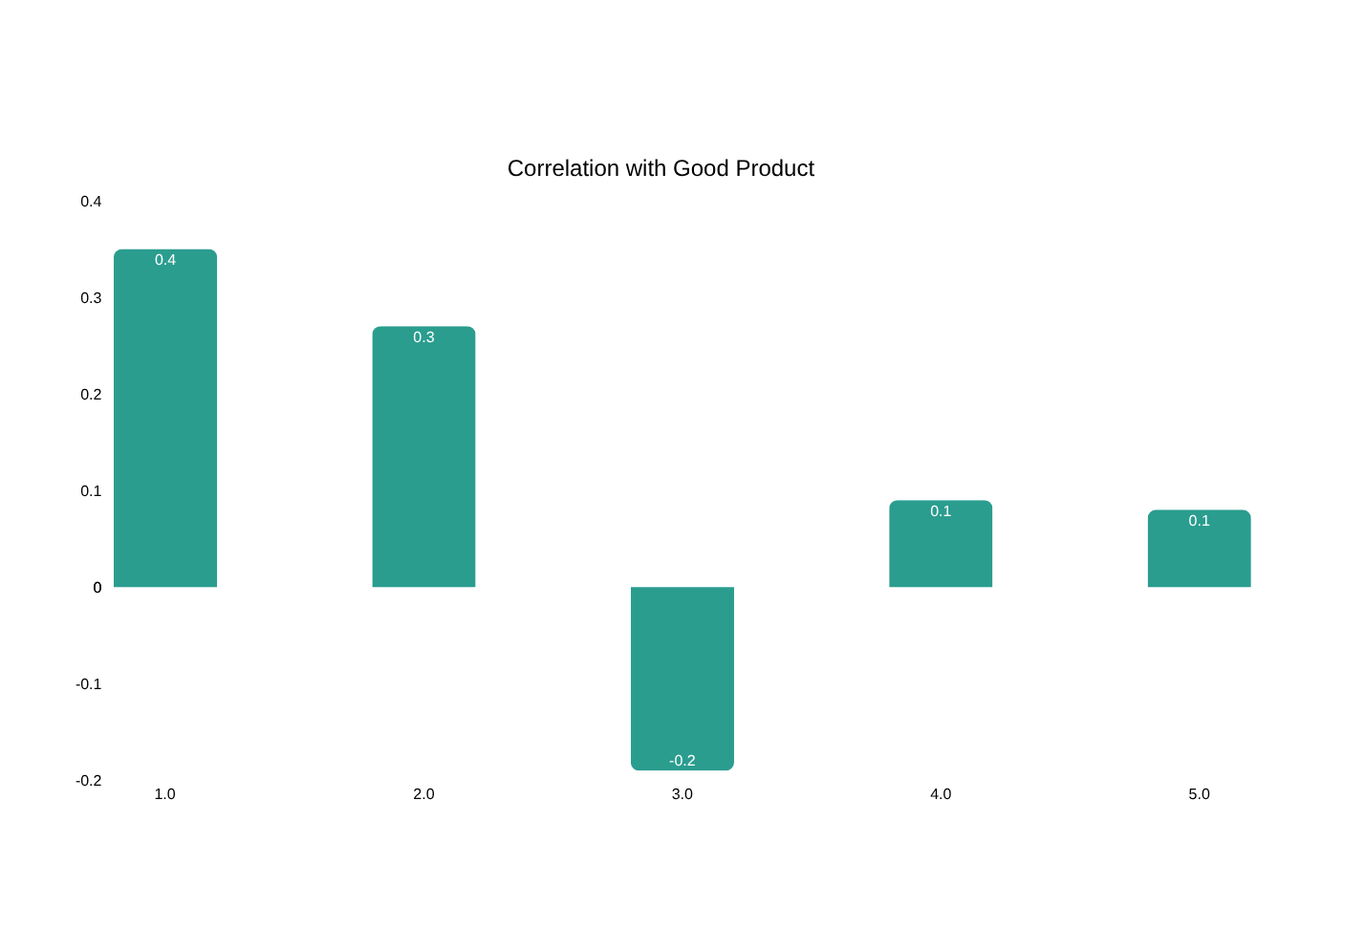
Q10
What relates most to a 'Good Product'?
ANSWER
Storage, then price
Good Product was defined as rating >= 4.2 (72% of listings), with rating excluded. Storage ranks first in correlation, regression and random forest (AUC 0.90), then price. Discounts matter little. Memory is distorted by mixed-unit RAM.
Notes:
13

Slide 14
Thank You
Notes:
13

